Slide 1
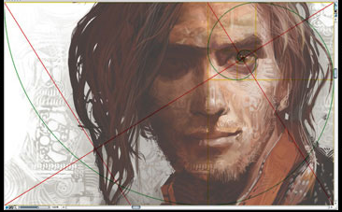
Golden Rectangle Symmetry
Michael S. Schneider www.constructingtheuniverse.com

Slide 2
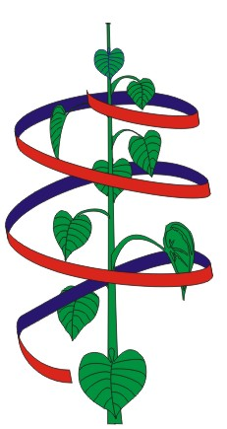
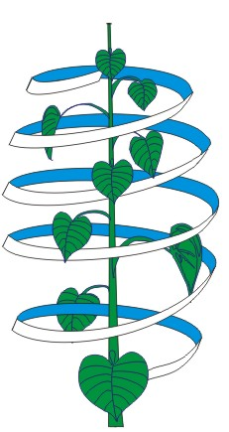
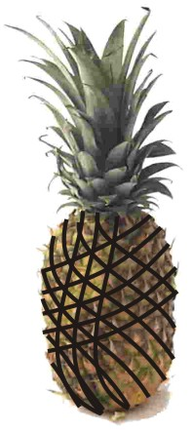
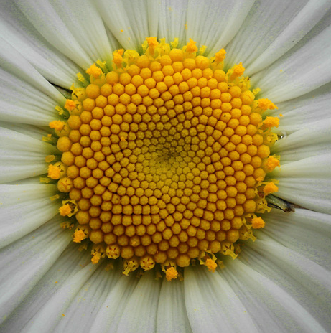
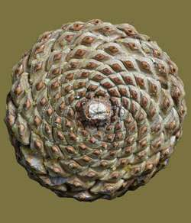
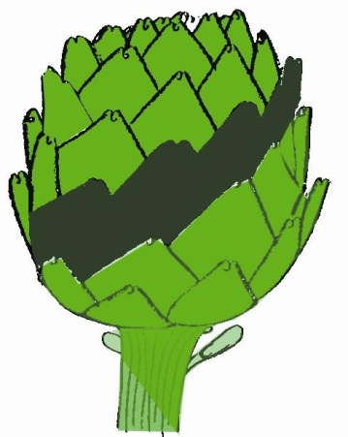
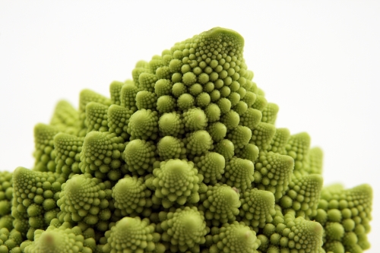
0, 1, 1, 2, 3, 5, 8, 13, 21, 34, 55, 89, 144, 233, …
21, 34
3, 5
5, 8
When a plant shows
consecutive Fibonacci Numbers
it reveals it’s own approximation
of the Golden Ratio.
Better approximation needed
Lesser approximation needed
8, 13
5, 8

Slide 3
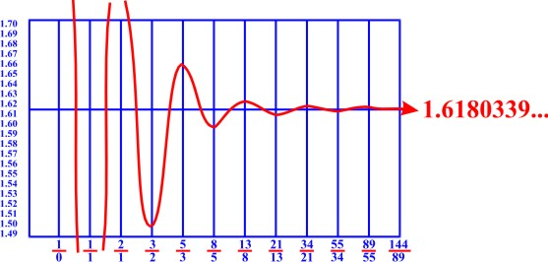
Fibonacci Fractions tend towards the ideal Golden Ratio
0, 1, 1, 2, 3, 5, 8, 13, 21, 34, 55, 89, 144, 233, …
Golden Ratio
1.618
1.62
Φ

Slide 4

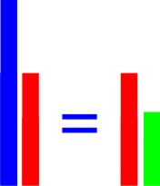
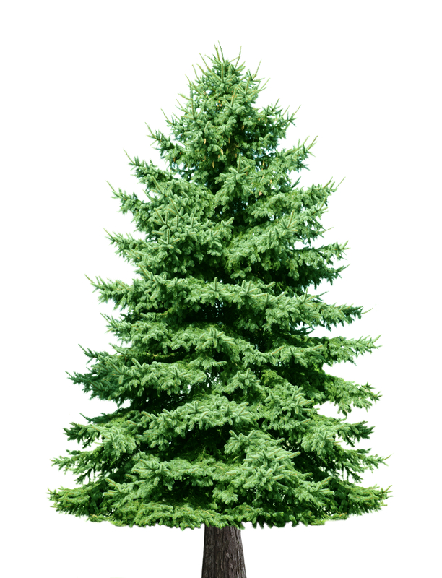
The Golden Ratio
= 1.618…
1
.618
The parts simultaneously balance with each other and with the whole.
That’s why one branch of a tree often resembles the whole tree!
Whole
The whole is to the large part, as the large part is to the small part.
1.618…
Large Part
Large Part
1
1
Small Part
.618…

Slide 5
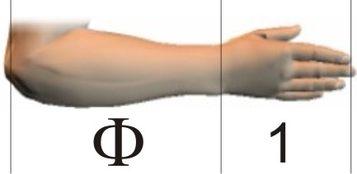
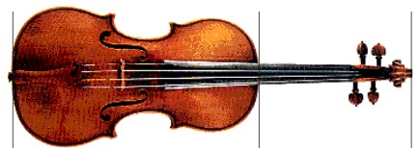
The whole is to the large part,
as the large part is to the small part.
1.618
1
1
.618
=
1.618…
1
.618
Large part
Small part

Slide 6
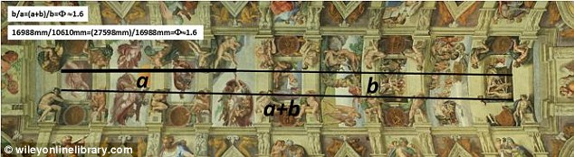
Sistine Chapel ceiling
Michelangelo

Slide 7
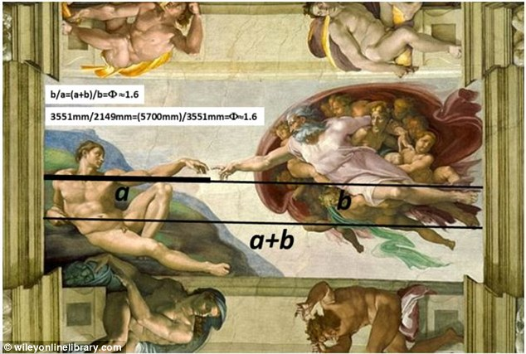

Slide 8
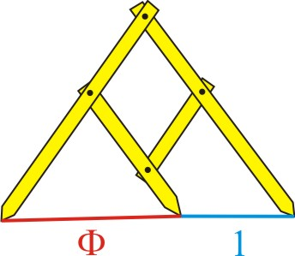
Page 98
Golden Ratio Calipers
1.618…
1
1.618

Slide 9
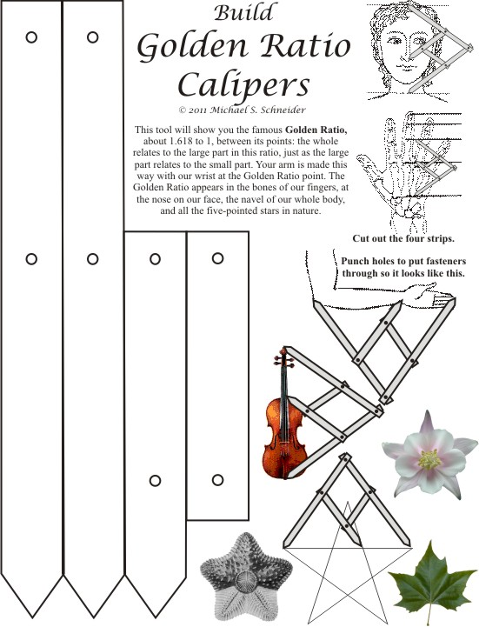
Page 98
Distances are between the holes.
1.618
1.618
1.618
1.618
2.618
2.618
1

Slide 10
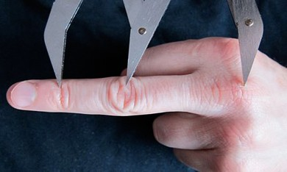

Slide 11
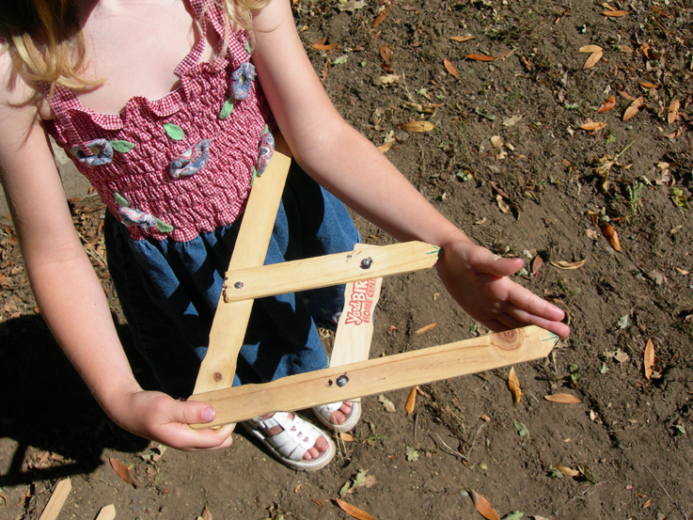
Our Whole Cubit is to the larger part as the larger part is to our hand length.
1.618
1

Slide 12
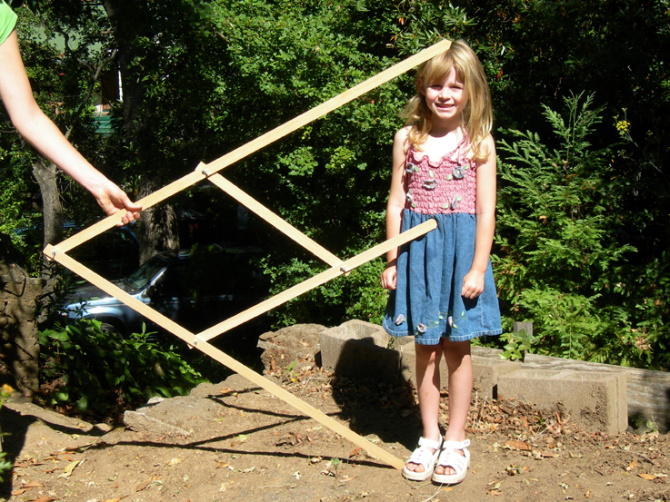
Her Whole height is to her Lower Part as
Her Lower Part is to her Upper Part
2.618 is to 1.618
as
1.618 is to 1
1
1.618

Slide 13
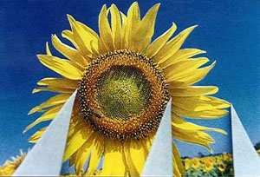
1.618…
1

Slide 14
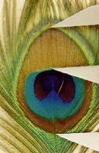
Peacock
Feather
1
1.618

Slide 15
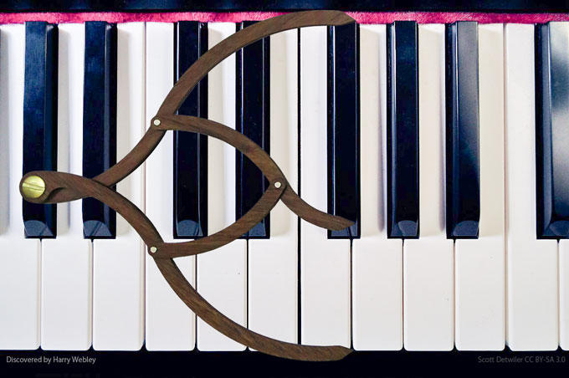

Slide 16
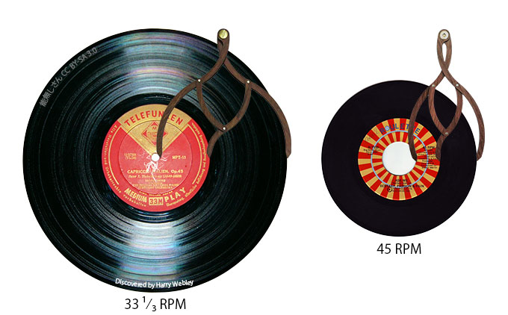

Slide 17
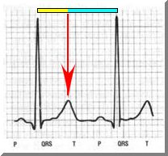
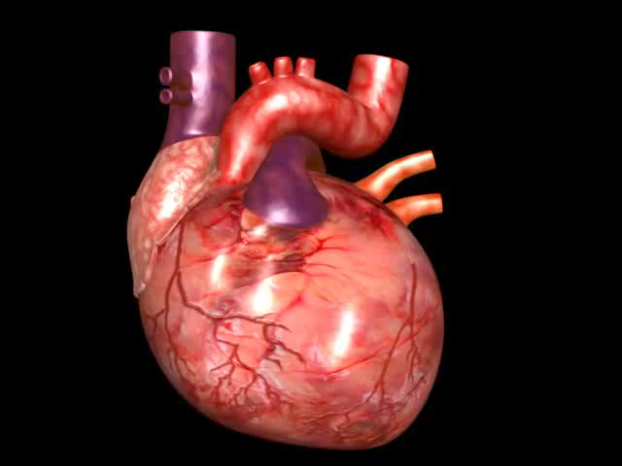

The whole heartbeat is to the large part, as the large part is to the small part.
whole heartbeat
Lub – Dupp!
small
large
Heartbeat
EKG

Slide 18
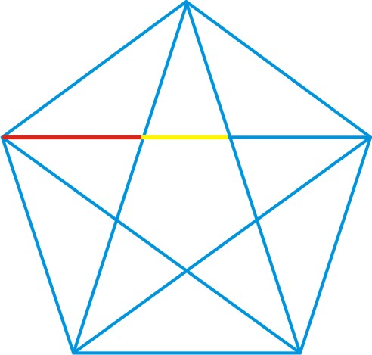
The Golden Ratio appears wherever the Pentagram crosses itself!
1.618…
1

Slide 19
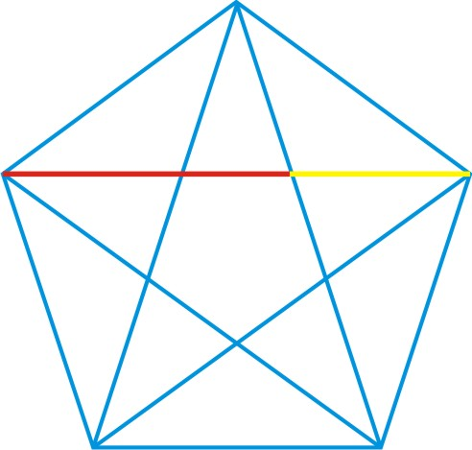
The Golden Ratio appears wherever the Pentagram crosses itself!
1.618…
1

Slide 20
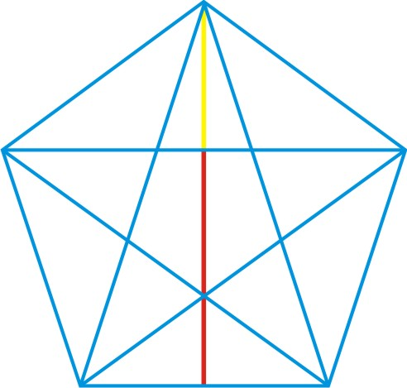
The Golden Ratio appears wherever the Pentagram crosses itself!
1
1.618…

Slide 21
A Golden Rectangle has sides in the Golden Ratio:
1
1.618…

Slide 22
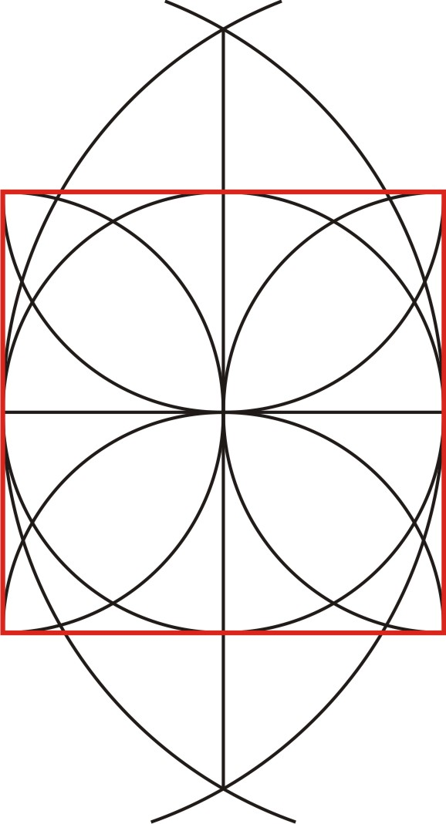
Page 91
To construct a Golden Rectangle
start with a square.

Slide 23
1
1

Slide 24
Drawing this red line isn’t necessary – it just shows where to open the compass between.
Midpoint

Slide 26
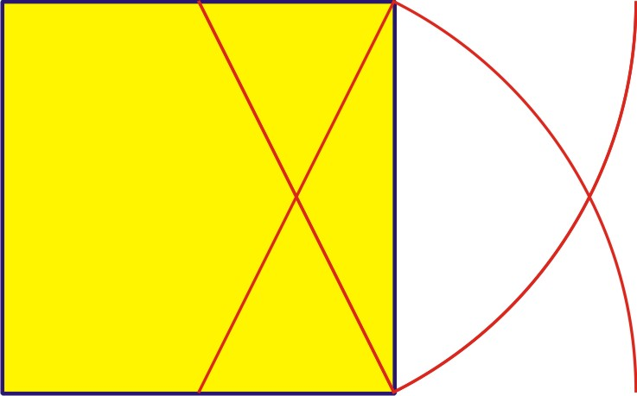
Make an arc in the upward direction too!

Slide 27
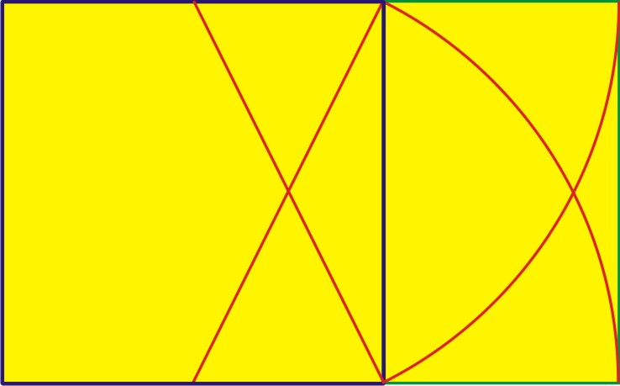
The whole is a large Golden Rectangle.
And this small rectangle added onto the square is a small Golden Rectangle!
1
1
.618
The area of the large Golden Rectangle is to the area of the square
as
the area of the square is to the area of the small Golden Rectangle!

Slide 28
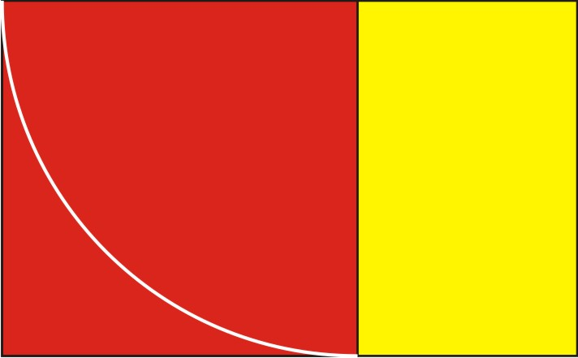
The Golden Rectangle
is also known as
the rectangle of “whirling squares”
because drawing a square in a Golden Rectangle
always leaves a smaller Golden Rectangle.

Slide 29
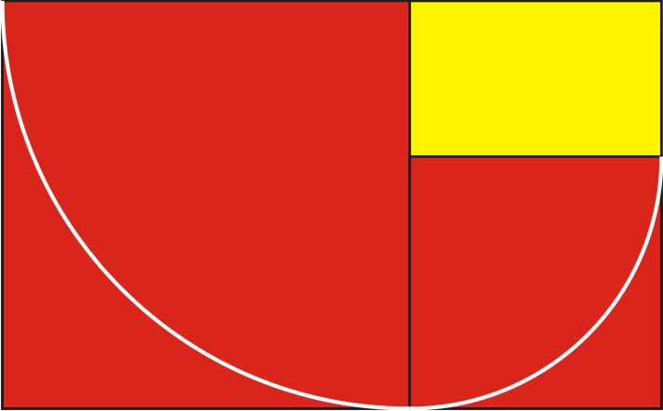

Slide 30
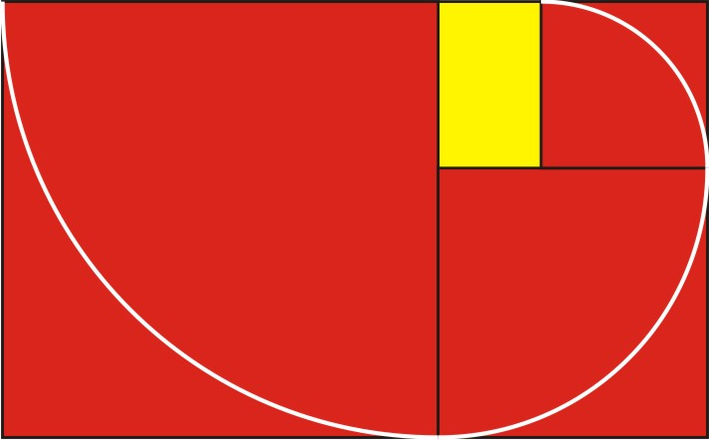

Slide 31
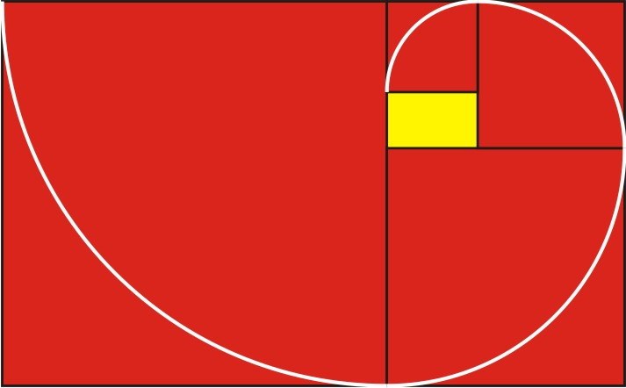

Slide 32
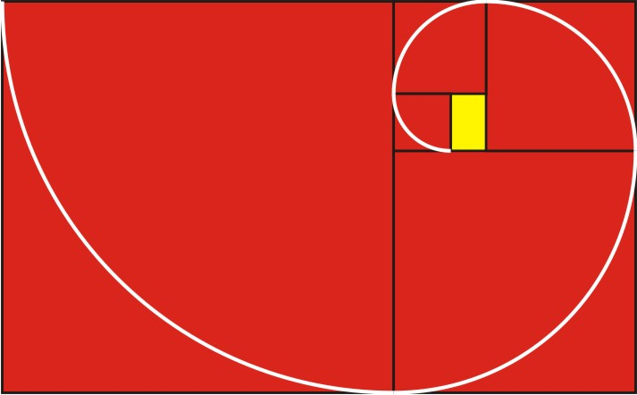

Slide 33
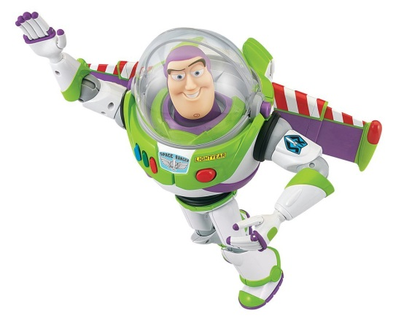
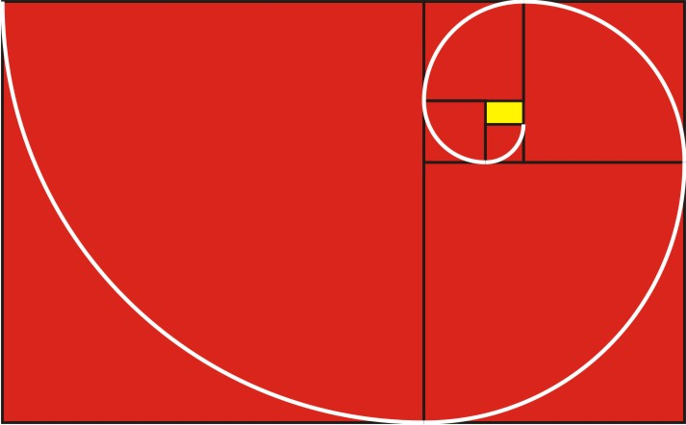
“To infinity
and beyond!”
-- Buzz Lightyear

Slide 34
You can find the spiral’s “eye” without drawing the spiral.
Just draw the diagonals of
the full Golden Rectangle
and the smaller Golden Rectangle

Slide 35
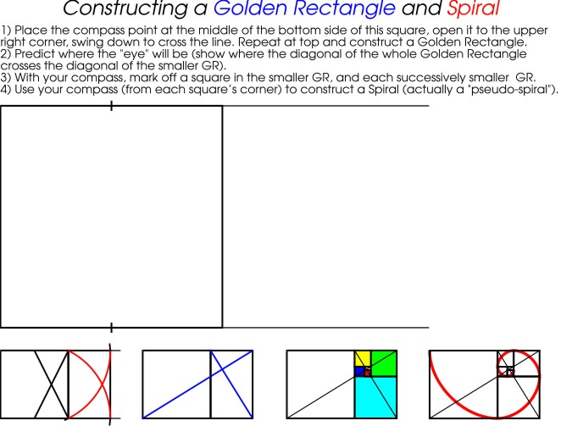
Page 91

Slide 36


Slide 37
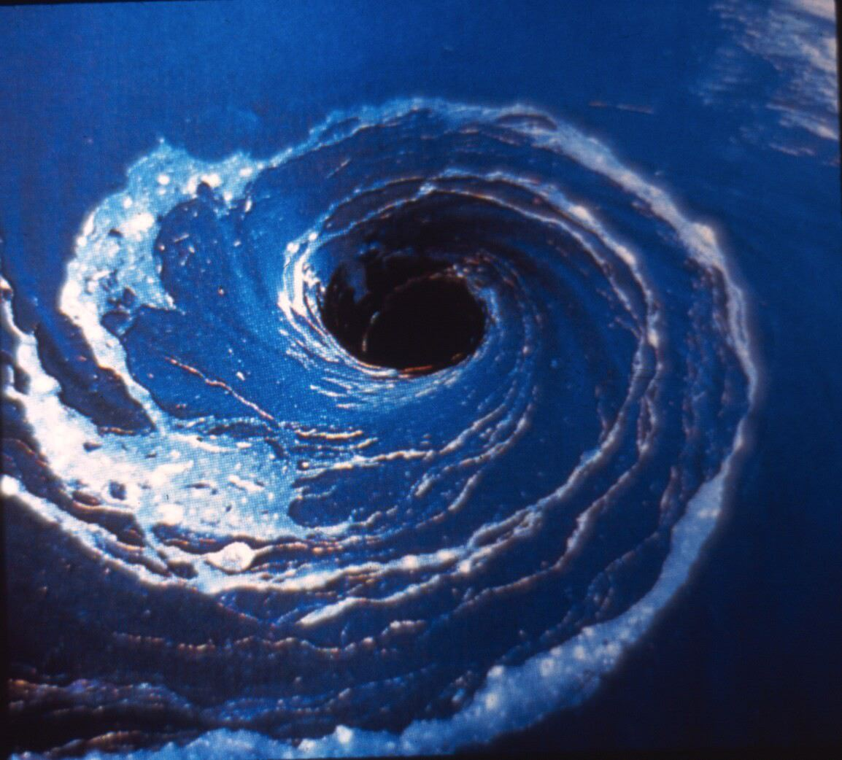

Slide 38
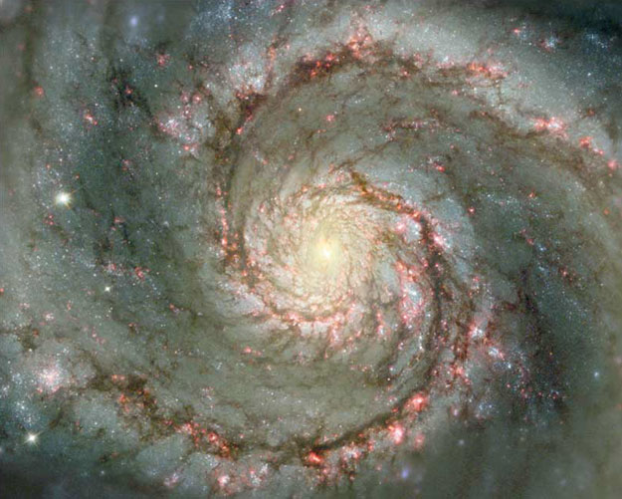

Slide 39
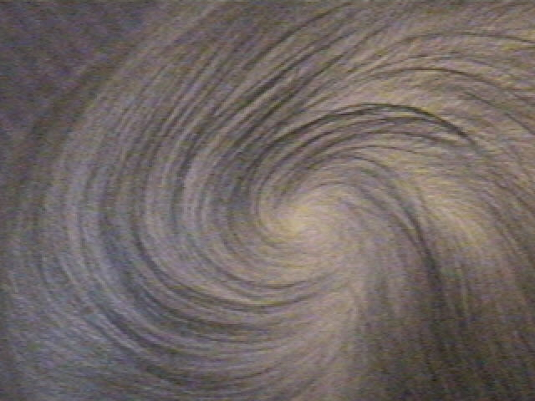

Slide 40
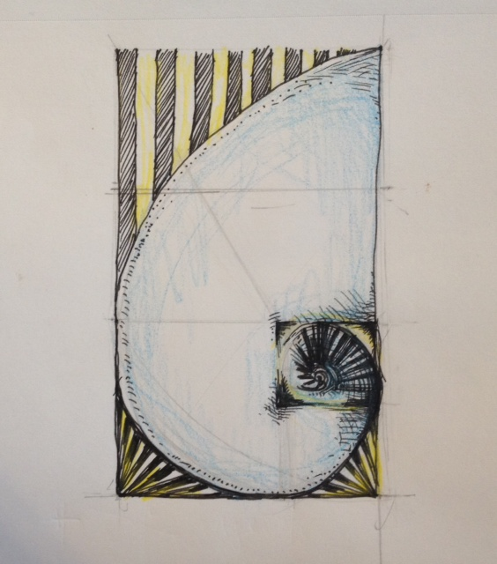
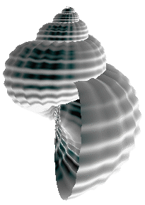
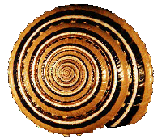
devon matlock

Slide 41
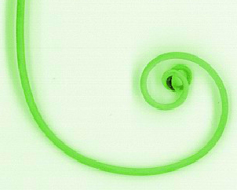
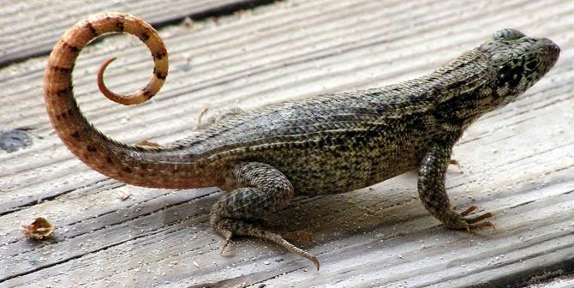
Pea Tendril
Growing size &
greater weight,
but the same balance!

Slide 42
Page 92

Slide 43
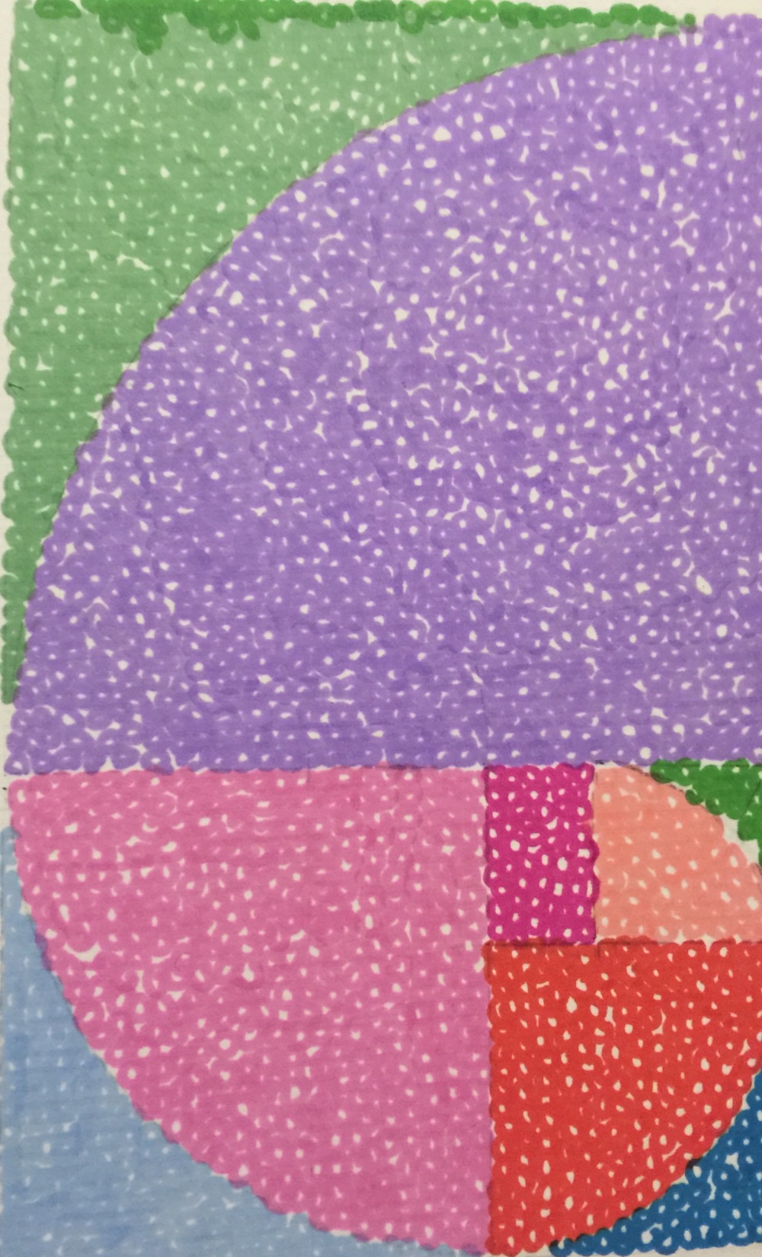
Cynthia Mao

Slide 44
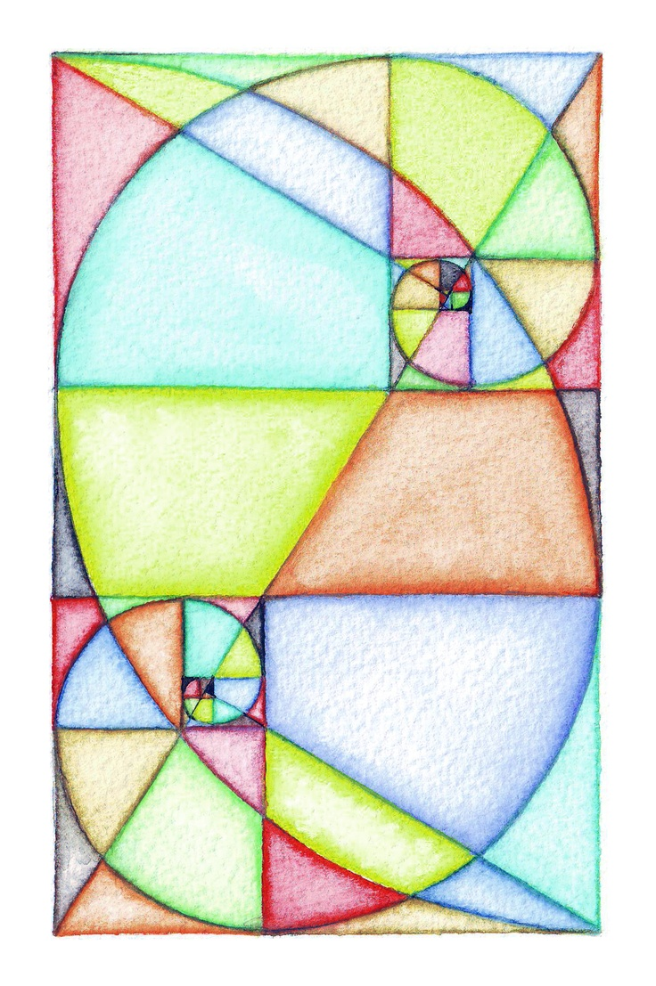

Slide 45

angela chong

Slide 46
Page 93
Visual Center of Gravity, a Point of “Balance”
Whatever you put there seems to stand out in the picture.

Slide 47


Page 93

Slide 48

Page 94
The house is intended to be the visual center of gravity

Slide 49

Page 94

Slide 50

Page 94

Slide 51

Page 93

Slide 52

Page 93

Slide 53

Sophia Kwon

Slide 54


Slide 55



Slide 56

shye showalter

Slide 57


Slide 58

Page 94

Slide 59

Page 94

Slide 60



Slide 61

Cropping a photo as a Golden Rectangle
First ask: Where is the visual center of gravity?

Slide 62

Identifying the visual center of gravity automatically shows you
how to find the Golden Rectangle around it!

Slide 63


Slide 64

Page 97

Slide 65

Museum of the Golden Ratio
museumofthegoldenratio.org
http://www.museumofthegoldenratio.org/artists__contemporary.htm

Slide 66


Slide 67
Homework?

Slide 68
End

Slide 69

https://www.youtube.com/watch?v=gBxeju8dMho&feature=youtu.be

Slide 70


Slide 71




Slide 72

1.618…
1

Slide 73


Slide 74


Slide 75

Page 95
Do this one.

Slide 76

A
Golden Rectangle

Slide 77

Square
Smaller
Golden Rectangle

Slide 78

Page 107
Visual
center of gravity

Slide 79


Slide 80

Quilt

Slide 81




Slide 82

Flikr
Page

Slide 83


Slide 84


Slide 85

If the square is made into a cube
it becomes a 3-dimensional box

Slide 86

Roughly a Golden Rectangle

Slide 87


Slide 88

1.618
1

Slide 89


3 Golden Rectangles make a GR frame, which holds the proportions of a pentagram star

Slide 90




Slide 91



Slide 92



Slide 93



Slide 94


Slide 96

A Golden Spiral balances in the same way no matter it’s size!

